Slide 1
Pattern Recognition in Movie Data
This project recognizes patterns among the variables that affect the performance of movie at the box-office.
Submitted by –
Avijit Sengupta Himanshu Agrawal Mounika Kancharla Ravi Shankar Maruvada
Notes:
A brief introduction and our brainstorming sessions.
Initial ideas of making models for ad’s and market analysis.
Our constraints for that idea.

Slide 2



Introduction
Idea:
As a part of the project we are trying to analyze patterns and build predictive models that can estimate the performance of a movie based on its popularity in social media and sentiment analysis for 2016 movies from IMDB data.
Notes:
The final idea and what we wanted to do.

Slide 3


Data collection
IMDB Data.
Facebook Popularity (Sentiment Analysis from Comments.)
YouTube Popularity.
Notes:
Issues we faced with twitter data.
Collection and cleaning of data.
What all and how we collected the data.
Schyuzet package, fb api code, youtube and imbd data.
Fat data and data cleaning.

Slide 4
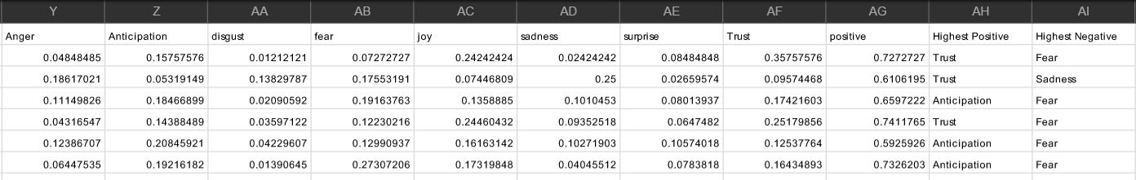
Sentiment analysis
Syuzhet Sentiment Analysis Package : https://cran.r-project.org/web/packages/syuzhet/index.html
R and Facebook API.
Generated Attributes
Dimensional Reduction

Slide 5
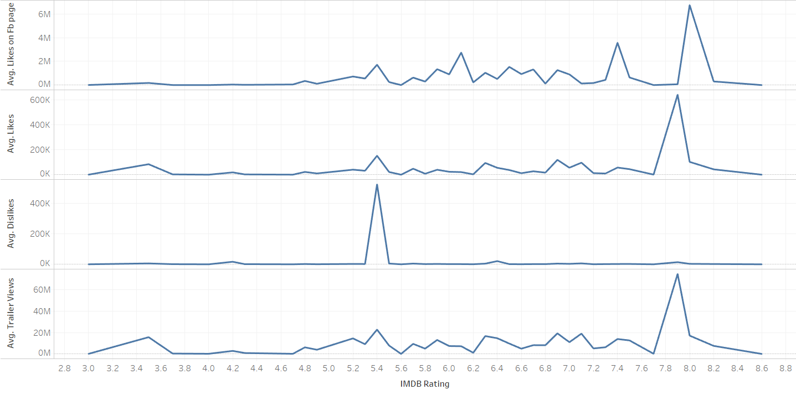
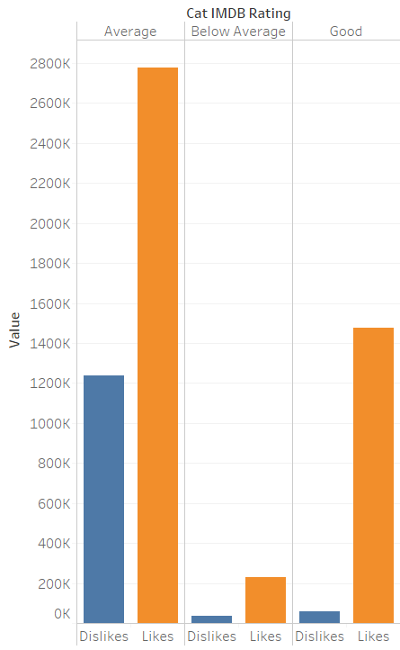
Pattern detection
Tableau IBM Watson Weka
Notes:
Explain weka pattern detection k-mean clustering
Ibm Watson data visualization

Slide 6
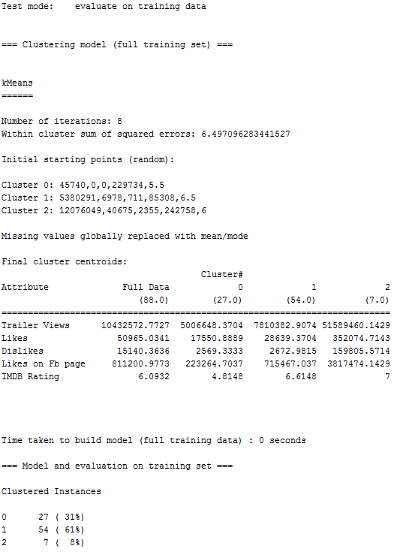
k-Means clustering
K MEANS CLUSTERING
3 clusters for IMDB ratings again suggest the same patterns found earlier with Trailer Views, Likes, Dislikes and Likes on FB page

Slide 7
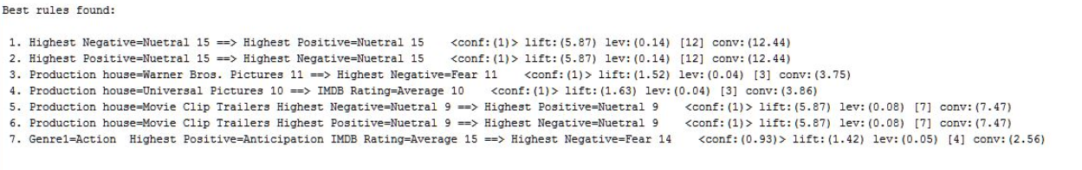
Apriori Algorithm

Slide 8
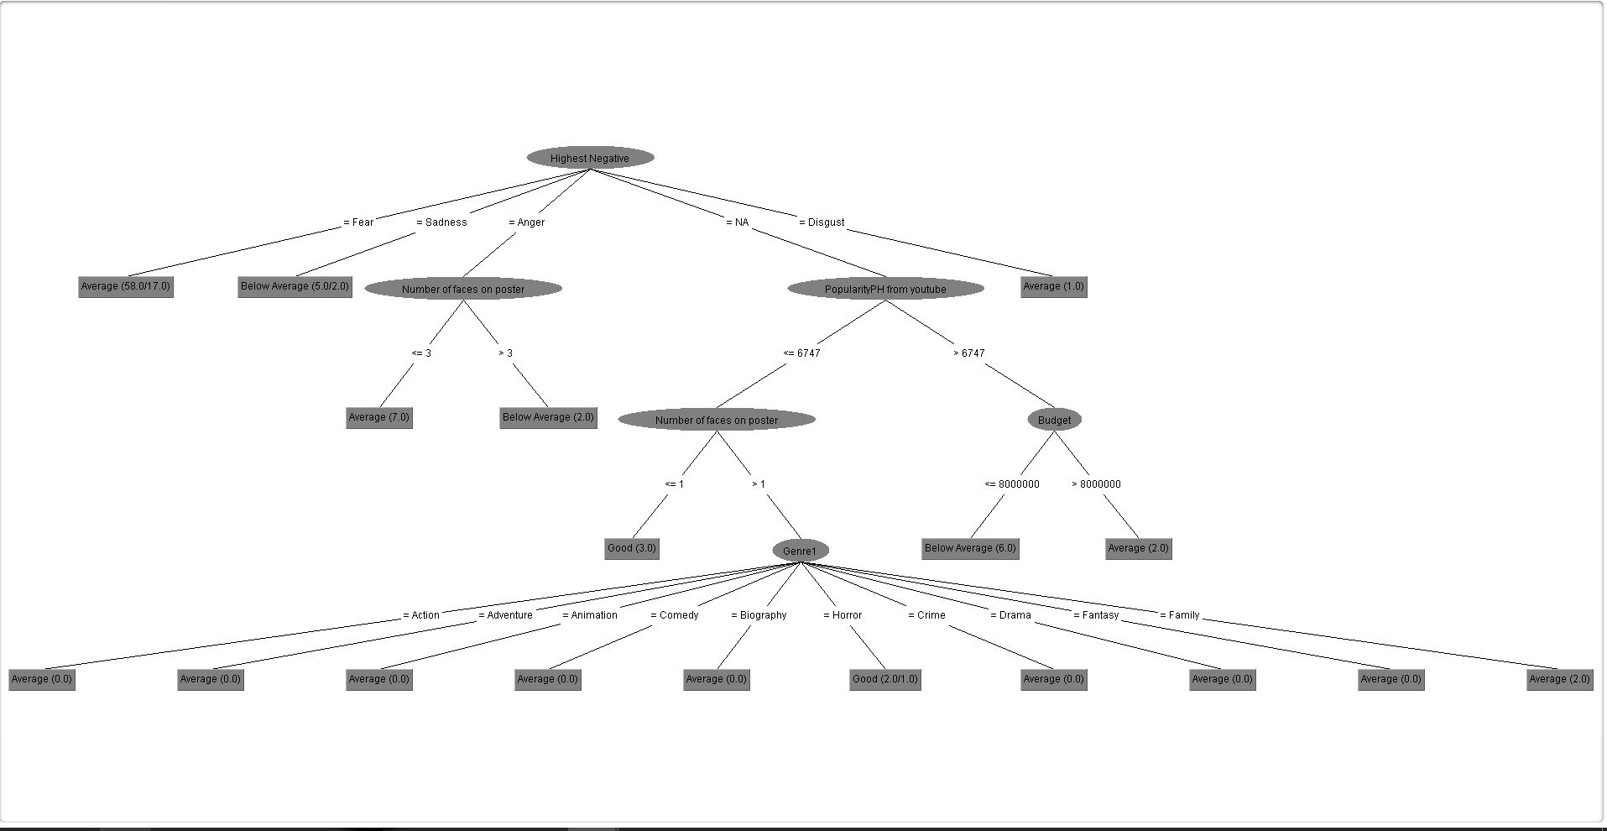
Decision Tree
Decision Tree 1:
Number of leaves: 18
Size of tree: 23
Accuracy: 54%

Slide 9
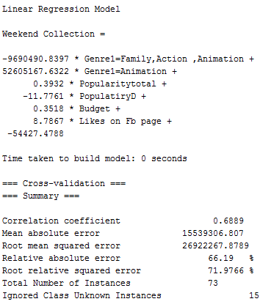
Linear Regression
Movie Name | Real Value | Predicted Value
Kong: Skull Island | 60M | ~64M
Boss Baby | 51M | ~75M

Slide 10
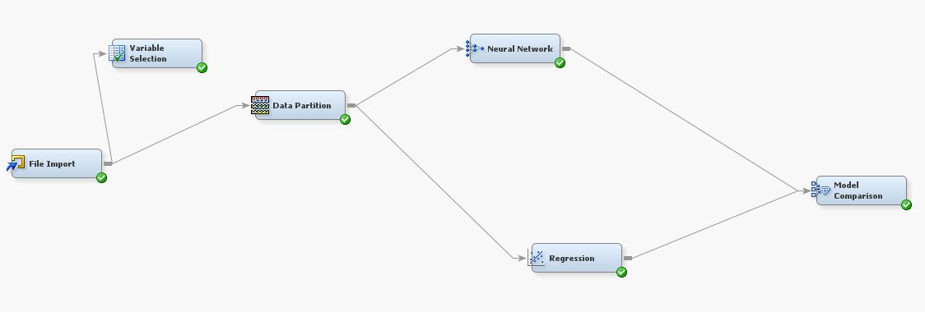
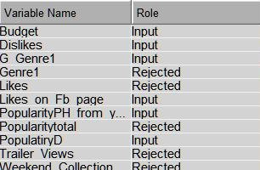
Neural Network
Neural Network:
Accuracy: 70%
Prediction for: IMDB Ratings.

Slide 11
SUGGESTIONS?? QUESTIONS??

